Slide 1
Learning Objective
I will be able to use the rules of derivative to differentiate functions.
Success Criteria
At the end of the lesson, I will be able to:
Apply the rules of derivative to differentiate functions.

Slide 2





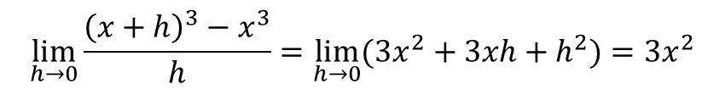

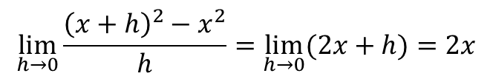

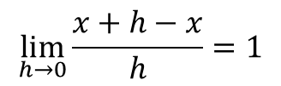
Rules of Derivative
Concept Development
$$f(x)$$ | Using first principles of derivative | $$f′(x)$$
$$x$$
$$x^{2}$$
$$x^{3}$$
$$x^{4}$$
$$x^{5}$$
$$⋮$$
$$x^{n}$$
$$\lim_{h→0}{\frac{x+h−x}{h}}=1$$
$$1$$
$$\lim_{h→0}{\frac{{\left(x+h\right)}^{2}−x^{2}}{h}}=\lim_{h→0}{(2x+h)}=2x$$
$$2x$$
$$\lim_{h→0}{\frac{{\left(x+h\right)}^{3}−x^{3}}{h}}=\lim_{h→0}{(3x^{2}+3xh+h^{2})}=3x^{2}$$
$$3x^{2}$$
$$4x^{3}$$
$$5x^{4}$$
$$nx^{n−1}$$

Slide 3

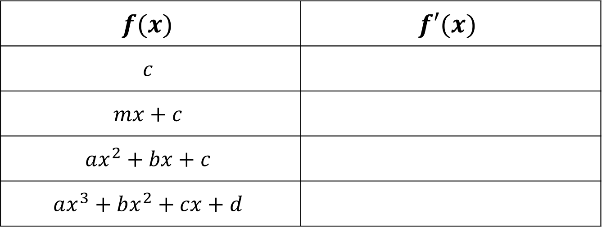



Rules of Derivative
Concept Development
$$f(x)$$ | $$f′(x)$$
$$c$$
$$mx+c$$
$$ax^{2}+bx+c$$
$$ax^{3}+bx^{2}+cx+d$$
$$0$$
$$m$$
$$2ax+b$$
$$3ax+2bx+c$$

Slide 4
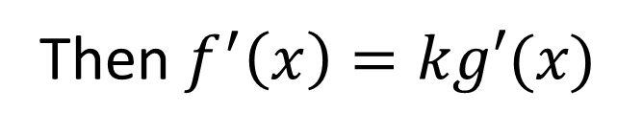
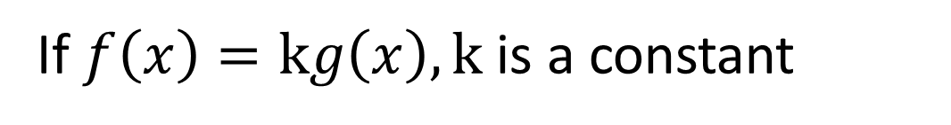



Multiplication rule by constant
Concept Development
If $f\left(x\right)=kg\left(x\right), k$ is a constant
Then $f^{′}\left(x\right)=kg′(x)$
Example:
$$f\left(x\right)=5x^{2}$$
$$f′\left(x\right)=5\left(2x\right)$$
$$f′\left(x\right)=10x$$

Slide 5
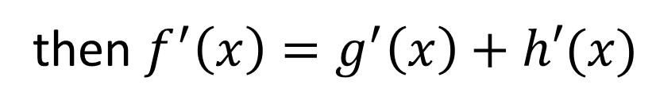
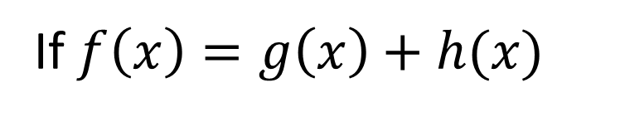


Sum rule
Concept Development
If $f\left(x\right)=g\left(x\right)+h(x)$
then $f^{′}\left(x\right)=g^{′}\left(x\right)+h′(x)$
Example:
$$f\left(x\right)=x^{2}+2x$$
$$f′(x)=2x+2$$

Slide 6
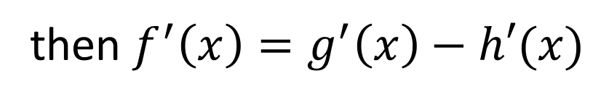
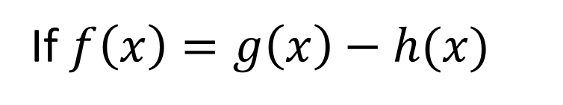


Difference rule
Concept Development
If $f\left(x\right)=g\left(x\right)−h(x)$
then $f^{′}\left(x\right)=g^{′}\left(x\right)−h′(x)$
Example:
$$f\left(x\right)=x^{2}−2x$$
$$f^{′}\left(x\right)=2x−2$$

Slide 7
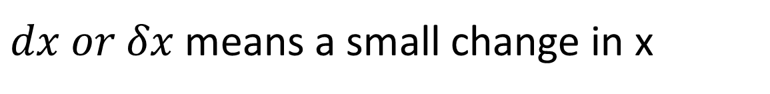
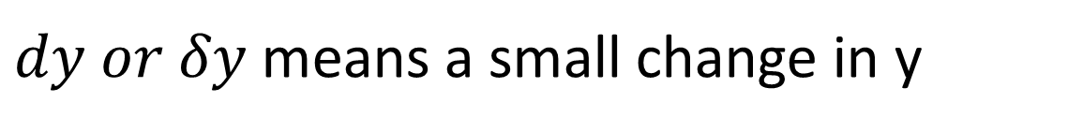
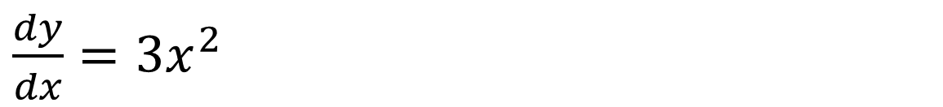
Alternative Notation
Concept Development
$f′\left(x\right)$ can also be written as $\frac{dy}{dx}$
Example:
If $y=x^{3}$ the derivative of y with respect to x is
$\frac{dy}{dx}=3x^{2}$
$dy or δy$ means a small change in y
$dx or δx$ means a small change in x

Slide 8
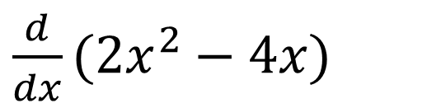


Alternative Notation
Concept Development
We can write:
Find the derivative of $2x^{2}−4x$ as
$\frac{d}{dx}(2x^{2}−4x)$
$$=4x−4$$

Slide 9

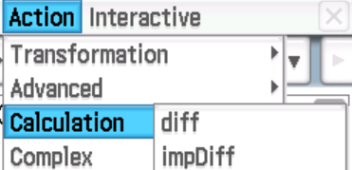
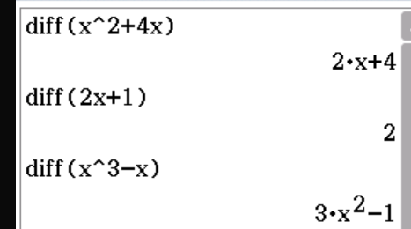
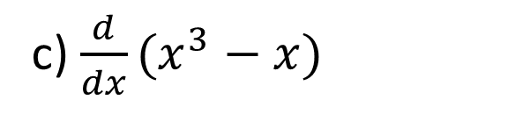
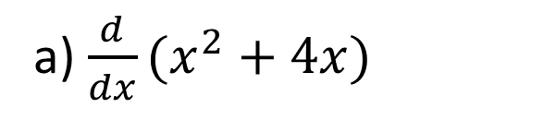

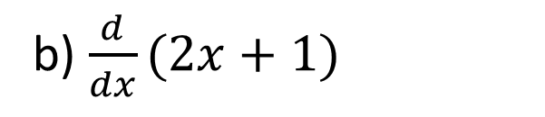


Guided Practice
a) $\frac{d}{dx}(x^{2}+4x)$
$$=2x+4$$
b) $\frac{d}{dx}(2x+1)$
$$=2$$
c) $\frac{d}{dx}(x^{3}−x)$
$$=3x^{2}−1$$

Slide 10
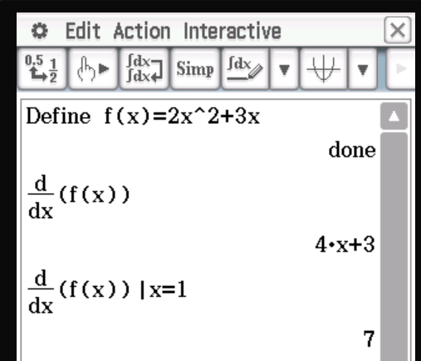
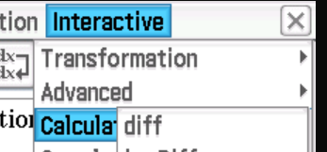
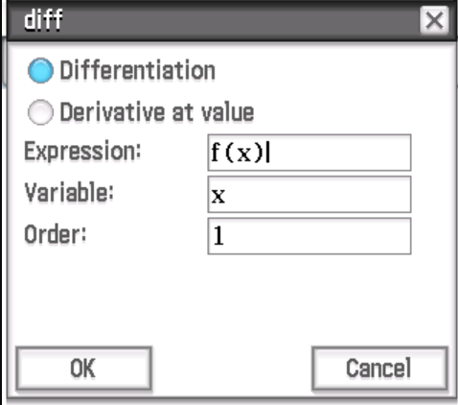
ClassPad

Slide 11

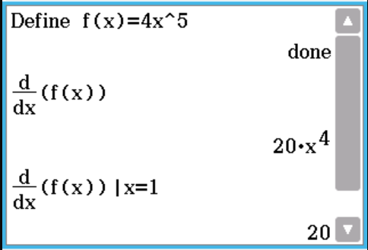
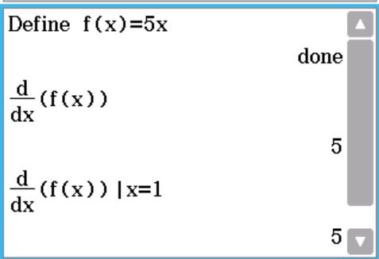

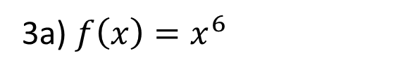
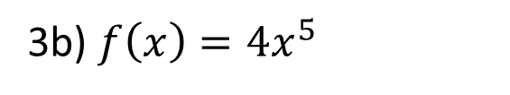




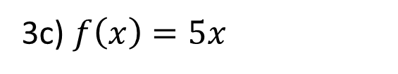

Guided Practice
This is asking you to find the derivative of f(x)
With respect to x, when x = 1
You are finding the instantaneous rate of change at x=1
3a) $f\left(x\right)=x^{6}$
3c) $f\left(x\right)=5x$
3b) $f\left(x\right)={4x}^{5}$
$$f′\left(x\right)=6x^{5}$$
$$f′\left(x\right)=5$$
$$f′\left(x\right)=20x^{4}$$
$$f′\left(1\right)=6$$
$$f′\left(1\right)=5$$
$$f′\left(1\right)=20$$

Slide 12

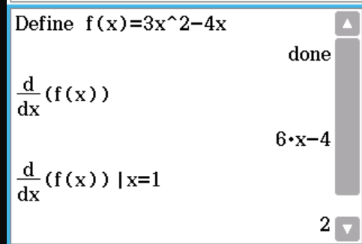
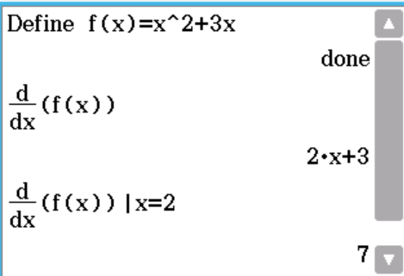

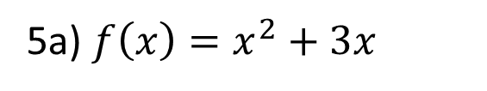

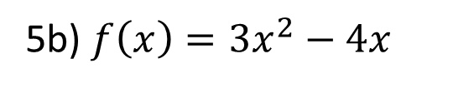


Guided Practice
You are finding the instantaneous rate of change at the given coordinate
Step 1: Find the derivative of f(x) with respect to x
Step 2: Substitute x-coordinate into f’(x)
5a) $f\left(x\right)=x^{2}+3x$
5b) $f\left(x\right)=3x^{2}−4x$
$$f^{′}(x)=2x+3$$
$$f^{′}(x)=6x−4$$
$$f′\left(2\right)=7$$
$$f′\left(1\right)=2$$

Slide 13
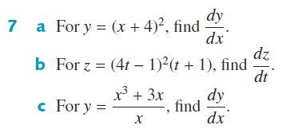
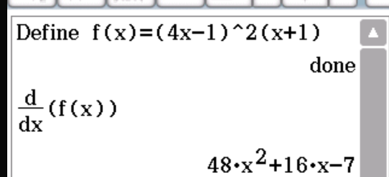
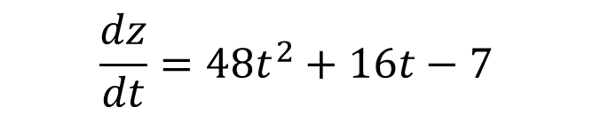


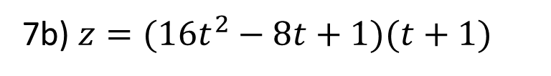
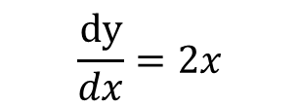
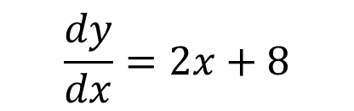
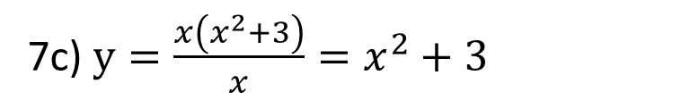
Guided Practice
7a) Expand the brackets
$$y=x^{2}+8x+16$$
$$\frac{dy}{dx}=2x+8$$
7c) $y=\frac{x\left(x^{2}+3\right)}{x}=x^{2}+3$
7b) $z=(16t^{2}−8t+1)(t+1)$
$$\frac{dy}{dx}=2x$$
$$z=16t^{3}+8t^{2}−7t+1$$
$$\frac{dz}{dt}=48t^{2}+16t−7$$

Slide 14
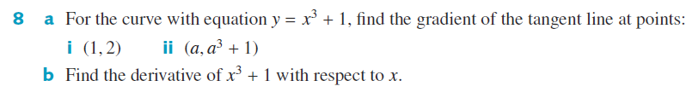
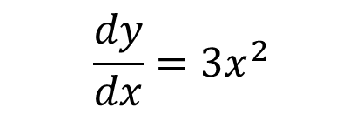
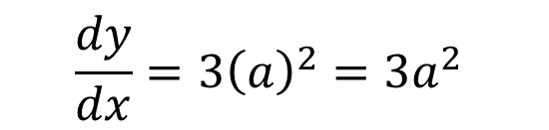

Guided Practice
$$\frac{dy}{dx}=3x^{2}$$
$$\frac{dy}{dx}=3{\left(1\right)}^{2}=3$$
$$\frac{dy}{dx}=3{\left(a\right)}^{2}=3a^{2}$$

Slide 15
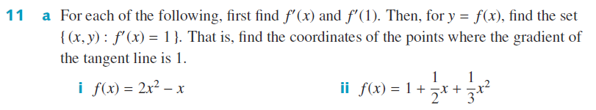




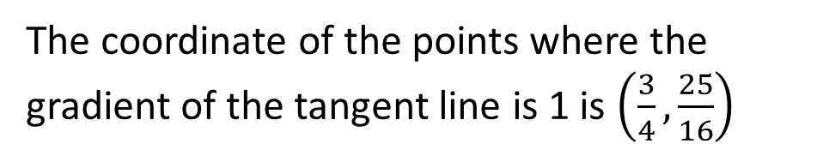
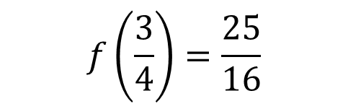
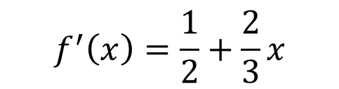


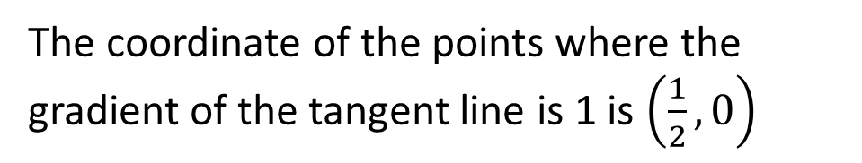
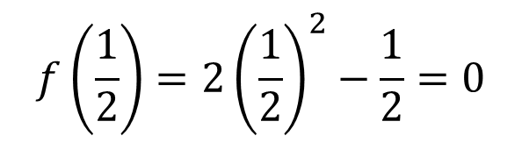
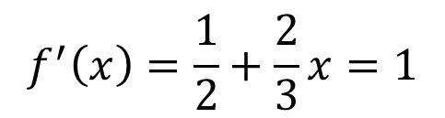
Guided Practice
$$f^{′}\left(x\right)=4x−1$$
$$f^{′}\left(x\right)=\frac{1}{2}+\frac{2}{3}x$$
$$f^{′}\left(1\right)=3$$
When gradient of tangent = 1, $f^{′}\left(x\right)=1$. Solve for x
$$f^{′}\left(1\right)=\frac{7}{6}$$
$$f^{′}\left(x\right)=4x−1=1$$
When gradient of tangent = 1, $f^{′}\left(x\right)=1$. Solve for x
$$x=\frac{1}{2}$$
$$f^{′}\left(x\right)=\frac{1}{2}+\frac{2}{3}x=1$$
$$f\left(\frac{1}{2}\right)=2{\left(\frac{1}{2}\right)}^{2}−\frac{1}{2}=0$$
$$x=\frac{3}{4}$$
$$f\left(\frac{3}{4}\right)=\frac{25}{16}$$
The coordinate of the points where the gradient of the tangent line is 1 is $\left(\frac{1}{2},0\right)$
The coordinate of the points where the gradient of the tangent line is 1 is $\left(\frac{3}{4},\frac{25}{16}\right)$

Slide 16


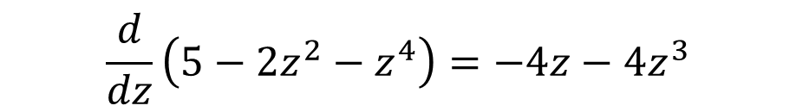


Guided Practice
12a)
$$\frac{d}{dt}\left(3t^{2}−4t\right)=6t−4$$
12b) $\frac{d}{dx}\left(4−x^{2}+x^{3}\right)=−2x+3x^{2}$
$$12c)$$
$$\frac{d}{dz}\left(5−2z^{2}−z^{4}\right)=−4z−4z^{3}$$

Slide 17













Guided Practice
12a) Differentiate y with respect to x
$$\frac{dy}{dx}=2x$$
12b) Differentiate y with respect to x
$$\frac{dy}{dx}=3x^{2}$$
Equate $\frac{dy}{dx}=gradient=8$
Solve for x
Equate $\frac{dy}{dx}=gradient=12$
$$2x=8$$
Solve for x
$$x=4$$
$$3x^{2}=12$$
Solve for y, $y=4^{2}=16$
$$x=±2$$
Coordinates = $(4,16)$
Solve for y, $y=2^{3}=8, y={\left(−2\right)}^{3}=−8$
Coordinates = $\left(2,8\right), (−2,−8)$

Slide 18












Guided Practice
12c) Expand and Differentiate y with respect to x
$$\frac{dy}{dx}=2−2x$$
12d) Differentiate y with respect to x
$$\frac{dy}{dx}=2x−3$$
Equate $\frac{dy}{dx}=gradient=2$
Solve for x
Equate $\frac{dy}{dx}=gradient=0$
$$2−2x=2$$
Solve for x
$$2x=0$$
$$2x−3=0$$
Solve for y, $y=0$
$$x=\frac{3}{2}$$
Coordinates = $(0,0)$
Solve for y, $y=−\frac{5}{4}$
Coordinates = $\left(\frac{3}{2},−\frac{5}{4}\right)$

Slide 19
Independent Practice
Complete Cambridge Ex 17D

